Slide 1







Zero to Hero AA Roadmap
A flavourful journey to elevate Byte & Bite to new heights

Slide 2



Key Vision & Principles for ABC PLC’s Success
A Parallel Build approach ensures balanced progress across initiatives.
Early Wins can build momentum and showcase our commitment.
Emphasizing Culture Change fosters employee engagement and ownership.
Our roadmap aims for sustained growth through innovation and teamwork.

Slide 3


Vision & Principles
We deliver impact through focused parallel waves, de-risk initiatives with feasibility and value scoring, and align deliverables to scale high-value use cases.
Early Wins
Feasibility & Value Scoring
Targeted Deliverables
Run work in parallel “waves” but limit to 2–3 active builds at a time. Balance data, people, and tech growth while delivering early wins to build confidence.
Use 1–5 scoring across Tech, People, Process, and Data to de-risk initiatives. Quantify potential topline/EBITDA uplift using proven impact-estimation frames from past roadmaps.
Deliver outputs aligned: AA roadmap, high-impact use-case portfolio, working prototypes, and a rollout plan to scale predictive and prescriptive capabilities.
(PREP → BUILD → SCALE)

Slide 4
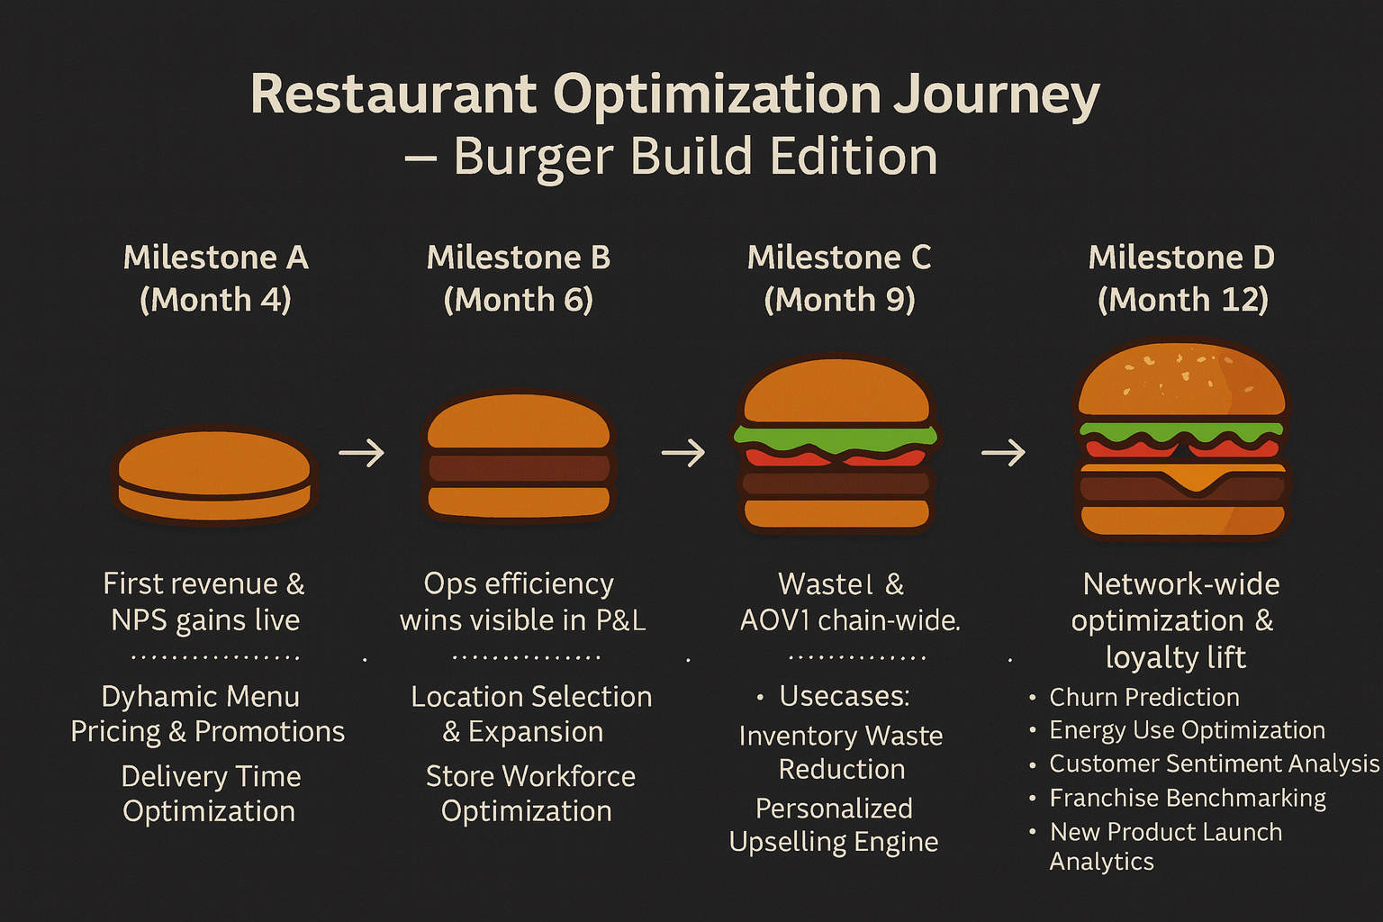


DASHBOARD
TIMELINES AND GANTT CHARTS

Slide 5


Feasibility & dependencies
People
Acceleration levers
Process
cultural shift to data‑driven ops
manager training
change champions per region.
pilot with manual/lean tools where tech gaps exist
use alternative SaaS for speed
standardize POS/CRM workflows
governance & model lifecycle.
Tech
External
permits & real estate for expansion
food safety & tax rules for pricing/promos
data‑privacy by region.
phased integrations
IoT where needed (ovens/energy)
geo‑data providers
mobile/driver apps.

Slide 6



Scaling & innovation playbook
Extend dynamic pricing to bundles/catering
Expand personalization across channels
Reuse geoanalytics for relocation/closure and micro‑market assortment
energy analytics → sustainability marketing.

Slide 7
THANK YOU

